Slide 1
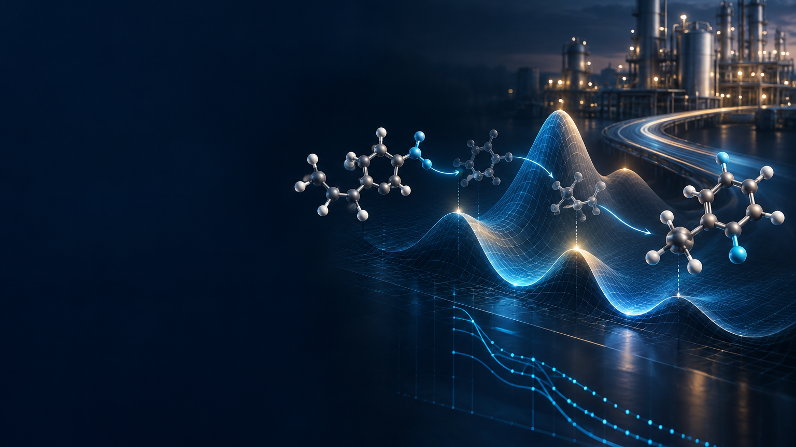

REACTION INTELLIGENCE
FOR PROCESS CHEMISTRY
Physics-based simulation and machine learning reveal why reactions fail — and what to test next.
CLIENT TECHNOLOGY OVERVIEW
www.aiqimia.com
p.jarowski@aiqimia.com
j.eggli@aiqimia.com
Notes:
CLIENT TECHNOLOGY OVERVIEW
Ai.Qimia provides reaction intelligence for process chemistry. We combine physics-based simulation and machine learning to reveal why a reaction fails and which experiment should be run next.
This deck shows the platform, a representative technical case, and a practical way to begin a client engagement.

Slide 2
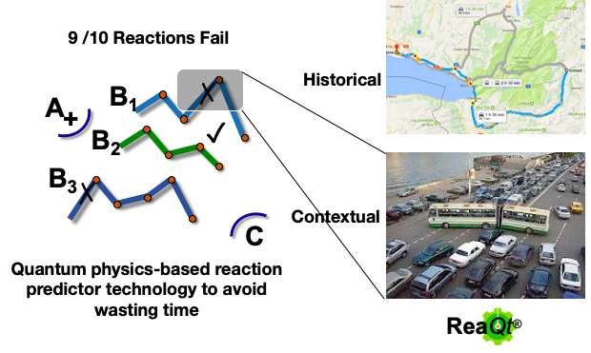
CLIENT TECHNOLOGY OVERVIEW
Published conditions often fail when the chemistry changes
02
A workable recipe for one molecule may fail after a small structural,
equipment or process change.
WHY TRANSFER FAILS
Literature conditions describe one substrate, one apparatus and one operating window.
A single atom can change protonation, selectivity or the rate-determining step.
Without a mechanism, chemists repeat broad screens to find the workable region again.
Representative campaign: 9 of 10 tested reactions failed
Notes:
THE TRANSFER PROBLEM
Published conditions are recipes for a specific molecule, apparatus and operating window. A small structural or process change can move the chemistry onto a different pathway.
In this representative campaign, nine of ten reactions failed. The platform is designed to explain that failure before the next broad experimental screen.

Slide 3
CLIENT TECHNOLOGY OVERVIEW
Ai.Qimia turns a synthesis question into decisions
03
A client does not receive another black-box score.
The output is an interpretable package a chemist can challenge, test and use.
01
02
03
ROUTE
MECHANISM
CONDITIONS
Which pathways and intermediates are viable?
What controls rate, failure and selectivity?
What should the laboratory test next?
Route feasibility • pathway risk • realistic intermediates
Transition states • rate-determining step • competing paths
Selectivity drivers • key variables • prioritized experiments
DELIVERABLE • Mechanism, predictions and a laboratory validation plan
Notes:
FROM QUESTION TO DECISION
We begin with the client's synthesis question and return three connected outputs: a viable route, an interpretable mechanism, and a prioritized experimental plan.
The goal is not to replace the chemist. It is to focus laboratory cycles on the conditions and transformations most likely to matter.

Slide 4
Physics and AI form a closed prediction loop
04
AI accelerates the expensive parts of simulation and directs where physics should look next
01
02
03
04
Evidence
Physics simulator
AI models
Decision
Literature, patents and client experiments
Structures, energies and reaction mechanisms
Δ-learning accelerates energies. Mechanistic ML prioritizes steps.
Route risk, selectivity and the next experiment
FEEDBACK
New experimental results improve the next prediction
The closed loop combines simulated ground truth with customer data while preserving a physics-based starting model.
Model development with HES-SO and the University of Geneva
Notes:
AI AND SIMULATION
AI.Qimia combines physics-based simulation with machine learning in a closed prediction loop.
The simulator creates mechanistically meaningful structures, energies and pathways. Delta-learning models accelerate repeated energy estimates, while mechanistic machine learning prioritizes likely steps and useful reaction waypoints.
Literature, patents and customer experiments provide additional evidence. New experimental results return to the data layer and improve the next prediction.
This keeps physics as the starting model while allowing AI to increase speed and learn across projects. The closed-loop model is being developed further with HES-SO and the University of Geneva.
Adapted from the supplied AI.Qimia Prediction Approach deck.

Slide 5
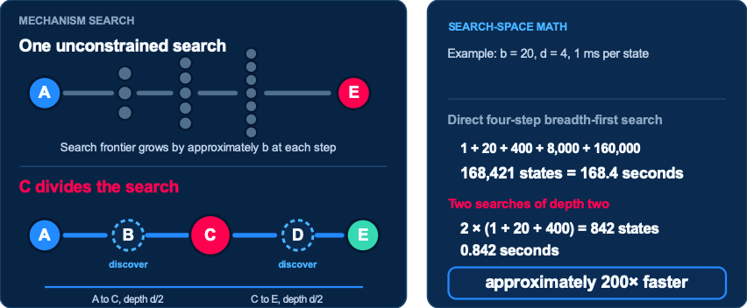
A learned midpoint divides the mechanism search
05
C constrains the route, but the platform must still discover B, D and the connecting transition states.
Energy predictions prune implausible branches before the expensive calculations.
Notes:
MIDPOINT-CONSTRAINED SEARCH
The route is A through B and C and D to E. A and E define the endpoints. Machine learning predicts a realistic central intermediate C.
C divides the full four-step search into two searches of depth two. The platform still has to discover the missing intermediates B and D and the transition states connecting every pair of minima.
For a concrete breadth-first-search example, assume 20 possible states at each step and one millisecond to evaluate each state. A direct depth-four search evaluates 168,421 states and takes 168.4 seconds. Two depth-two searches evaluate 842 states and take 0.842 seconds. The midpoint-constrained search is therefore approximately 200 times faster and evaluates 99.5 percent fewer states.
The example assumes uniform branching, a useful midpoint and equal cost per state. Molecular energy predictions can prune implausible branches further. Standard traversal of a graph that already exists remains O(V plus E). The saving comes from avoiding construction and evaluation of most of the graph.

Slide 6
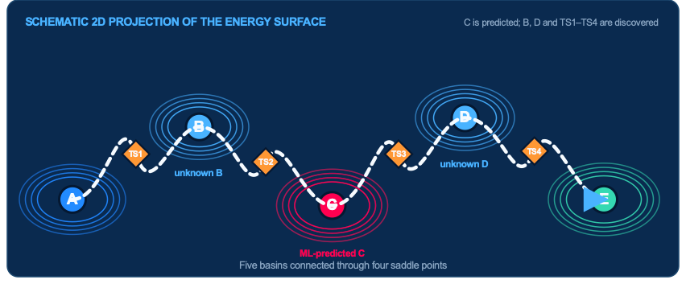
The simulator navigates the energy surface around the learned anchor
06
The search discovers B, D and four transition states while connecting A to E through C.
Notes:
DISCOVERING THE FULL MECHANISM
C is an anchor, not the complete mechanism. The platform searches outward in both directions to find B and D and the four transition states that connect A to E.
The graphic is a schematic two-dimensional projection of the underlying multidimensional energy surface. A, B, C, D and E occupy basins. TS1 through TS4 are saddle points. The dashed path represents the connected minimum-energy route through the surface.
This is the mechanistic information used to identify difficult steps, likely competing routes and the variables worth investigating experimentally.

Slide 7
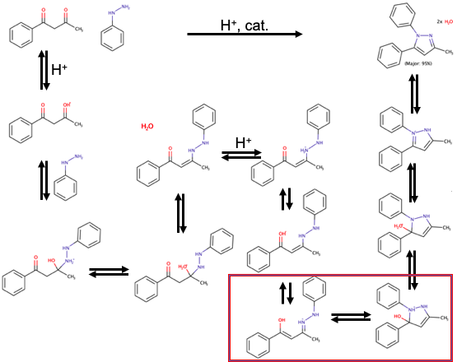
REPRESENTATIVE CLIENT USE CASE
Case study: mechanism and regiochemistry were both uncertain
07
THE DECISION
Which path is chemically viable?
Which transition state controls the rate?
Why does one regioisomer win?
A connected mechanism resolves viability, rate and regioselectivity.
Notes:
REPRESENTATIVE USE CASE
The client question was not simply whether a product could form. The mechanism, rate-controlling event and regioselectivity all had to be resolved together.
We computed the connected reaction network so that each prediction could be traced to explicit intermediates and transition states.

Slide 8
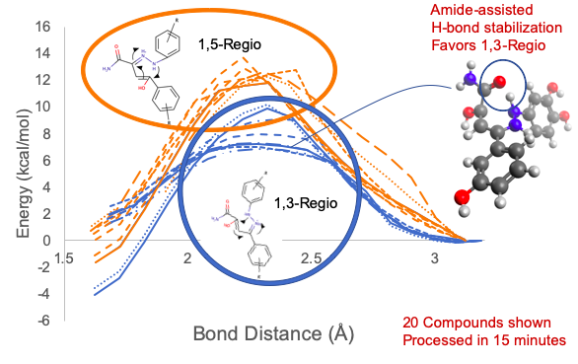
REPRESENTATIVE CLIENT USE CASE
The model explained the regioselectivity
08
MECHANISTIC INSIGHT
Amide-assisted H-bond stabilization favors the 1,3-regioisomer.
20
related compounds
processed in 15 minutes
Mechanistic insight explains the observed selectivity across related compounds.
Notes:
REGIOSELECTIVITY
The calculation explained why the 1,3-regioisomer is favored: an amide-assisted hydrogen-bond interaction stabilizes the relevant pathway.
The same analysis was applied to twenty related compounds in fifteen minutes, turning a mechanistic explanation into a scalable prediction workflow.

Slide 9
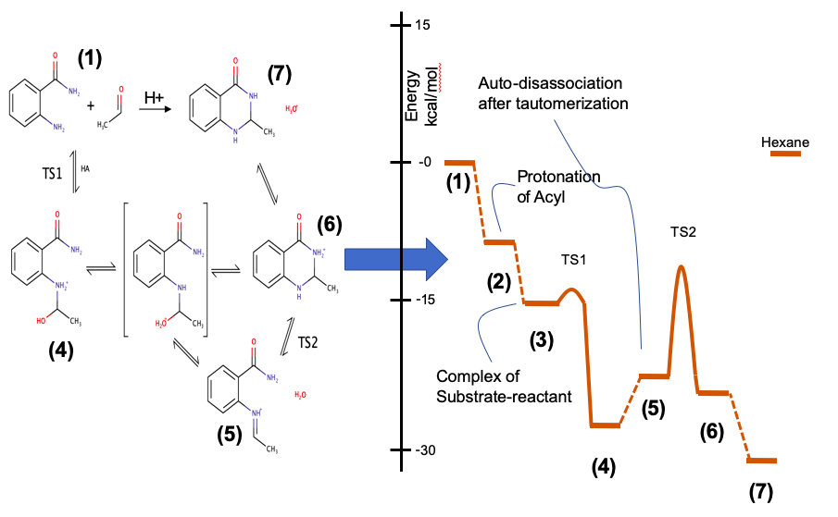
REPRESENTATIVE CLIENT USE CASE
From a 2D hypothesis to a quantitative mechanism
09
MECHANISTIC MODEL
We transform your 2D hypothesis into quantitative thermodynamic and kinetic data.
Thermodynamics ranks intermediates and pathways.
Kinetics identifies the controlling barriers and competing steps.
A quantitative definition of how the reaction works
Notes:
FULL MECHANISM
The computation resolved the proposed route into explicit molecular microstates and elementary steps.
That creates a design basis: the chemist can see where protonation, tautomerization, association, ring closure and product release enter the energy sequence instead of treating the reaction as a single opaque transformation.

Slide 10
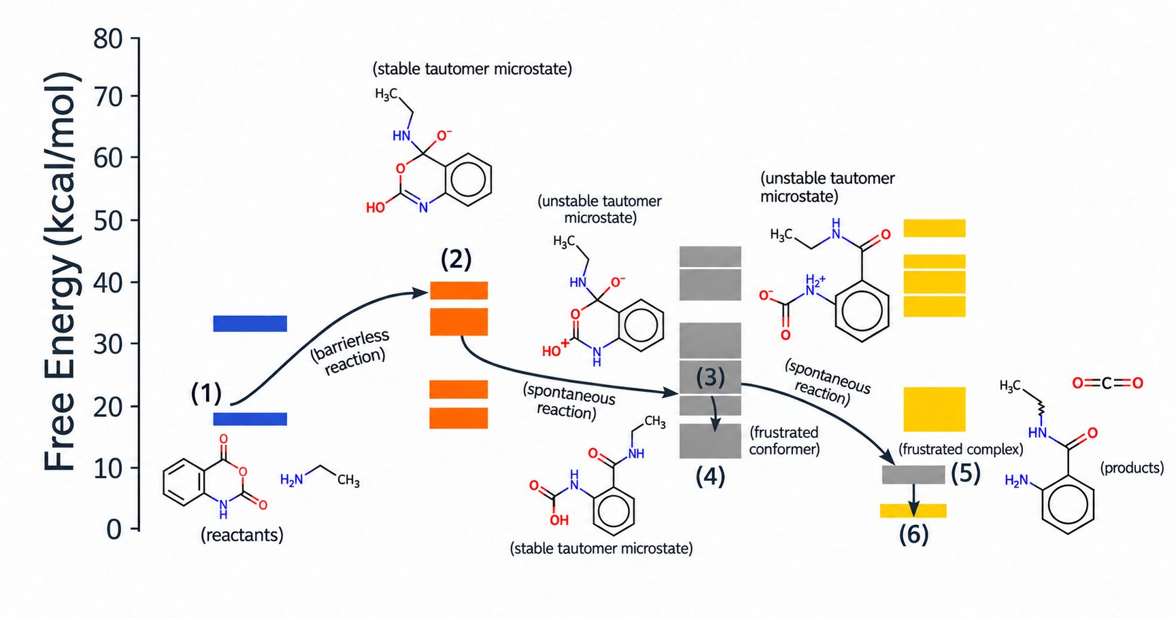
REPRESENTATIVE CLIENT USE CASE
Elementary steps across the microstate ensemble
10
FULLY ATOMISTIC
Each elementary step is resolved down to the microstate.
Tautomers, stereoisomers and conformers contribute according to their populations.
Single-state rate
kᵢ = κ(kBT/h) exp[−(Gᵢ‡−Gᵢ)/RT]
Boltzmann population
pᵢ = exp[−ΔGᵢ/RT] / Σⱼ exp[−ΔGⱼ/RT]
Observed ensemble rate
kobs = Σᵢ pᵢkᵢ
The reactive ensemble can differ from the lowest-energy structure alone.
Notes:
MICROSTATE ENERGY MAP
The correlation diagram compares the energies of the microstates across the proposed sequence.
The useful result is not simply an energy number. It is a connected path that identifies productive states and shows where alternative states become too costly to pursue.

Slide 11
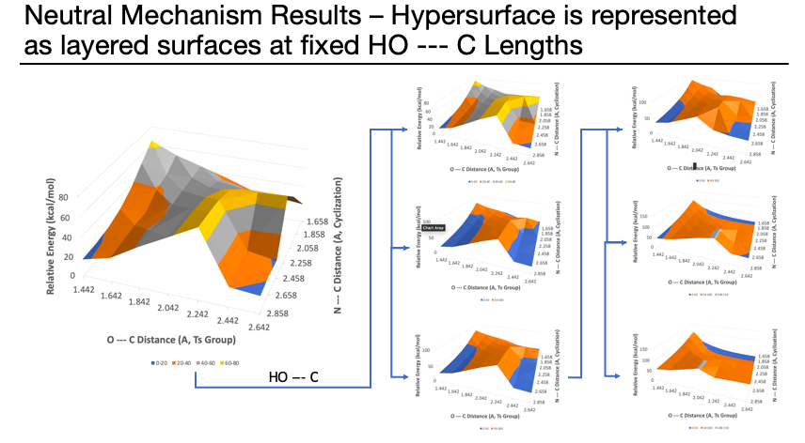
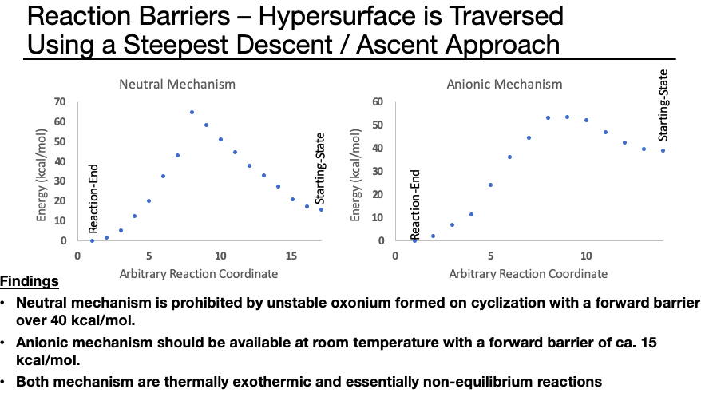
REPRESENTATIVE CLIENT USE CASE
Mechanistic insight changed the experimental decision
11
NEUTRAL PATH
>40 kcal/mol
Forward barrier prohibits the proposed neutral mechanism.
ANIONIC PATH
≈15 kcal/mol
Viable at r.t.; prioritize conditions consistent with this pathway.
Outcome: deprioritize the neutral route and focus validation on the anionic mechanism.
Notes:
EXPERIMENTAL DECISION
The proposed neutral mechanism had a forward barrier above forty kilocalories per mole and was therefore not viable under the intended conditions.
The anionic mechanism had a forward barrier of approximately fifteen kilocalories per mole and was accessible at room temperature.
The practical decision was to deprioritize the neutral route and focus experimental validation on conditions consistent with the anionic pathway.

Slide 12
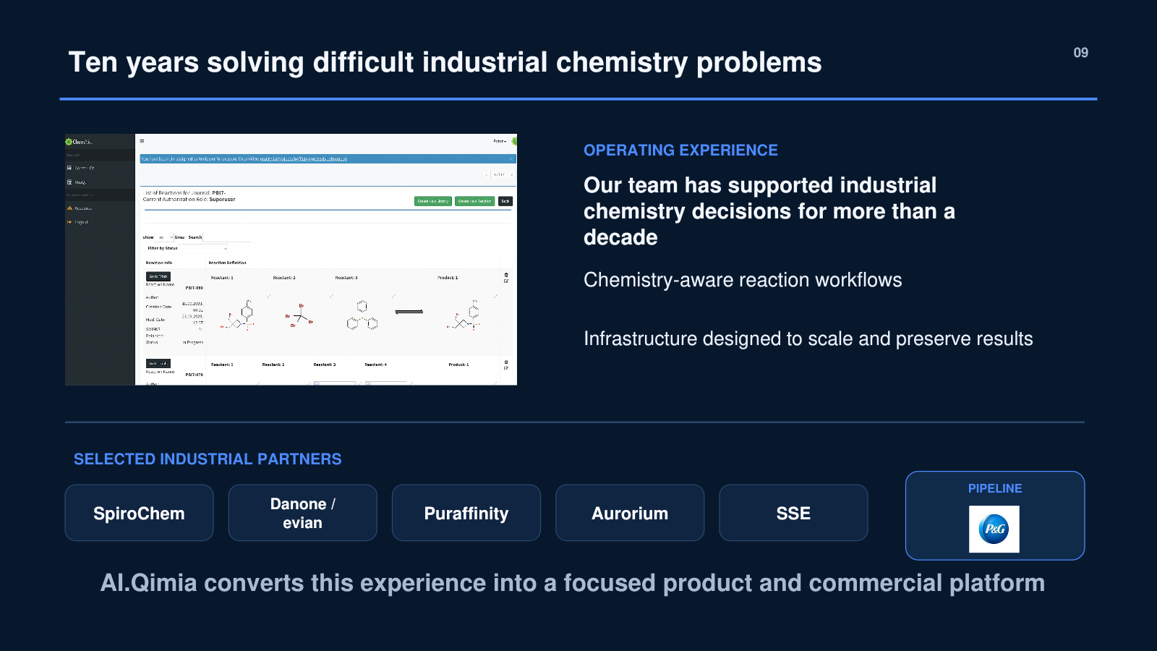
12

Slide 13
CLIENT TECHNOLOGY OVERVIEW
Paid pilots establish fit before software licensing
13
We solve one real reaction problem with your team. Once the workflow performs on your chemistry, we license the platform for repeat use.
01
02
03
04
SCOPE
PAID PILOT
VALIDATE
LICENSE
→
→
→
Select a reaction bottleneck and agree on measurable success
Build the mechanism and rank the experiments worth running
Compare predictions with laboratory results and refine the workflow
Deploy the proven workflow as software for your team
PAID PILOT
→
REPEATABLE WORKFLOW
→
SOFTWARE LICENSE
Have a reaction challenge? Please get in touch.
Peter D. Jarowski • p.jarowski@aiqimia.com • +41 78 817 27 36 • aiqimia.com
Avenue de la Gare, 1003 Lausanne, Switzerland
Notes:
CLIENT ENGAGEMENT
We begin with a paid pilot focused on one reaction problem and a measurable definition of success.
The pilot produces an interpretable mechanism, prioritized experiments and direct comparison with laboratory results. We refine the workflow until it performs on the client’s chemistry.
Once the workflow is repeatable and useful to the client team, we move to a software licensing model for continued use.
Contact: Peter D. Jarowski, p.jarowski@aiqimia.com, +41 78 817 27 36. Avenue de la Gare, 1003 Lausanne, Switzerland.

